Slide 1
Interactive Medium-fi Prototype
CJ Indart, Ginelle Servat, Grace Miller, Riley Pittman

Slide 2

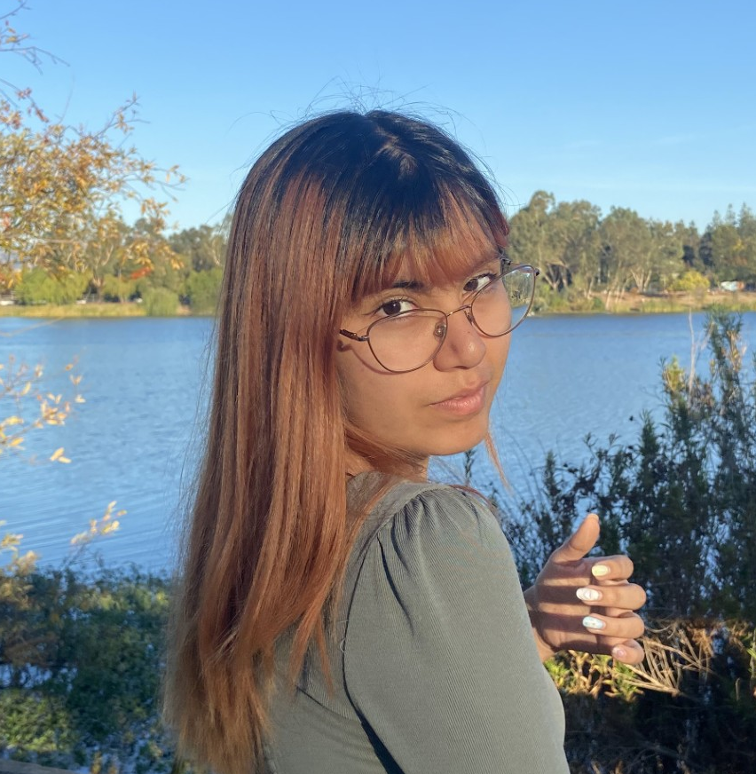
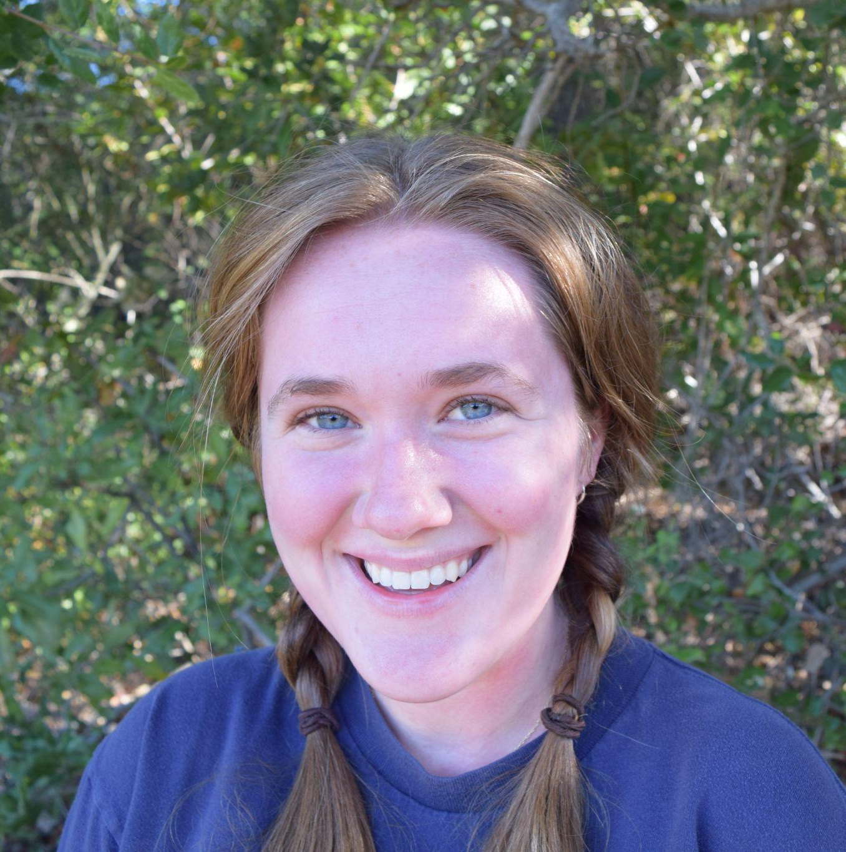

Our Team
CJ Indart
Ginelle Servat
Grace Miller
Riley Pittman

Slide 3

Students Connecting For Shared Success

Slide 4
Link to Figma Prototype
https://www.figma.com/proto/nPJsN6q5m7h1WMQgvdS9p5/Med-fi-prototype?node-id=63-792&node-type=canvas&t=CrO3pJJ84ZlCsDPL-0&scaling=min-zoom&content-scaling=fixed&page-id=0%3A1&starting-point-node-id=63%3A792

Slide 5

Value Proposition
The Problem
Our Solution
Students searching for jobs and post-graduate career options often feel isolated and alone
Connect students with similar interests to form community groups that provide support surrounding the job search

Slide 6
Values in Design
Teamwork
  GOAL: Encourage users to support one another as a group, with each member equally engaged & acknowledged
  DESIGN: Communication centered around group chat; no personal messaging functionality
Collaboration
  GOAL: Motivate users to collaborate in the job search, not compete
  DESIGN: Combine users from diverse backgrounds and in variable stages of the job search to support one another without competition
Transparency & Authenticity
  GOAL: Help users quickly build a support community and meaningful relationships built on emotional honesty
  DESIGN: Weekly check-ins invite users to participate in candid conversations early and often

Slide 7
Tasks (Unchanged)
Simple
Match users into groups based off career interests
Moderate
Set weekly goals
Complex
Participate in weekly check-ins regarding emotional & job search status

Slide 8
Revisions
New intermediate screen shows users as they’re being connected to a group
Navigation bar condensed to 2 tabs: the group tab and the personal tab.
Chat feature has been moved inside the group tab
In the personal tab, users now fill out check-in forms and goals there, and it displays a personal summary of these things
Group tab now displays a summary of teammates’ goals

Slide 9
Reasons for Revisions
Lo-fi prototype testers couldn’t identify when they had been matched with a group
We reasoned that using our tabs to highlight a group vs. self differentiation showcases our app’s purpose—without the chat page
Our low-fi prototype had too many redundant clicks on the home tab
Testers struggled to intuitively find their weekly check-in task flow when personal action items were present in both personal & group tab

Slide 10
Usability Goals
Intuitive UI
Likelihood to Use Feature
Measure the number of mis-clicks when users test
Participants rate how likely they are to use a feature from 1-10

Slide 11
Progress Towards These Goals
Goal 1:
During the first tests, users had 5 mis-clicks and reported difficulty finding the check-ins
To fix this, we now only have 2 tabs in the navigation bar: the personal tab and group tab
The personal tab has two buttons, one for adding goals and the other for doing check-ins, which requires fewer clicks
We will re-evaluate if we need to make it easier to navigate each task goal after the next round of tests

Slide 12
Progress Towards These Goals
Goal 2:
While none of the features received ratings of under 5 in the last test, the chat feature was among the lowest score
So, we removed the chat from the navigation bar since it will be used less often and put it in the right hand corner of each tab
We will re-evaluate if there are any features we should remove after the next round of tests

Slide 13
Revised Sketches

Slide 14
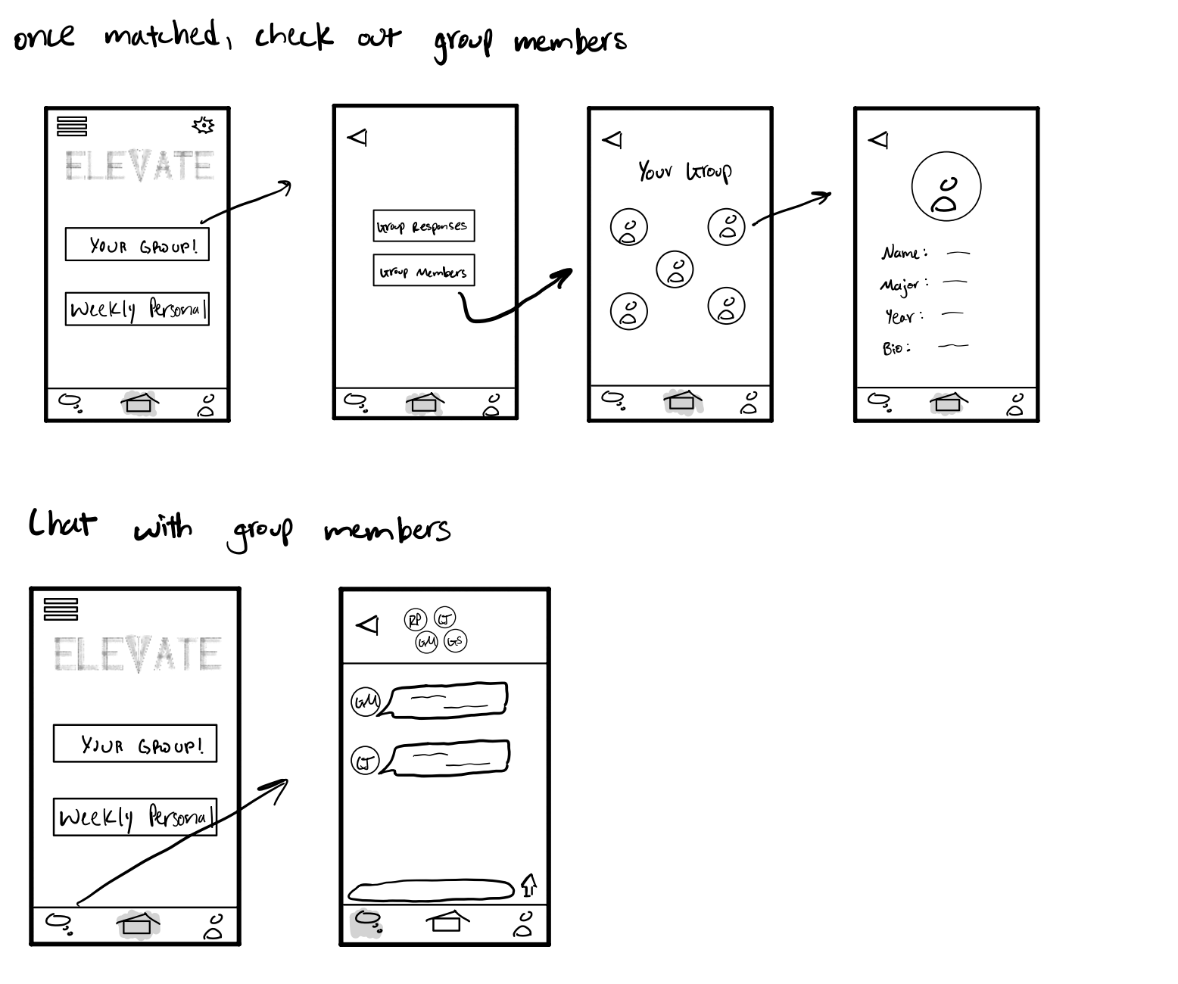
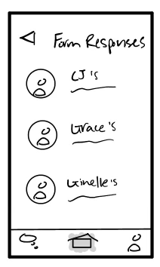
Original: Looking at Group Members and Check-ins

Slide 15
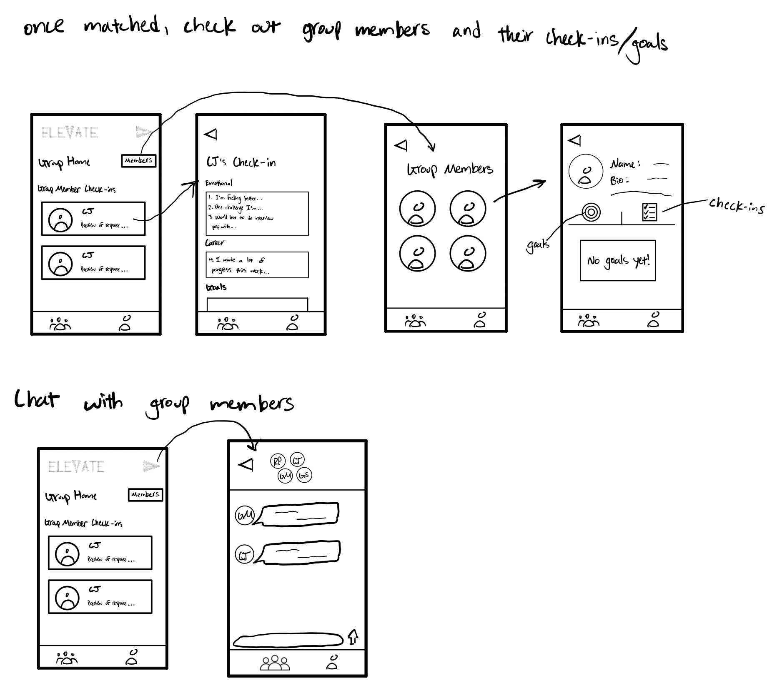
New: Looking at Group Members and Check-ins
Description:
There are now only two navigation tabs for easier navigation
View member check-ins and goals in the Group Home to make it more intuitive

Slide 16
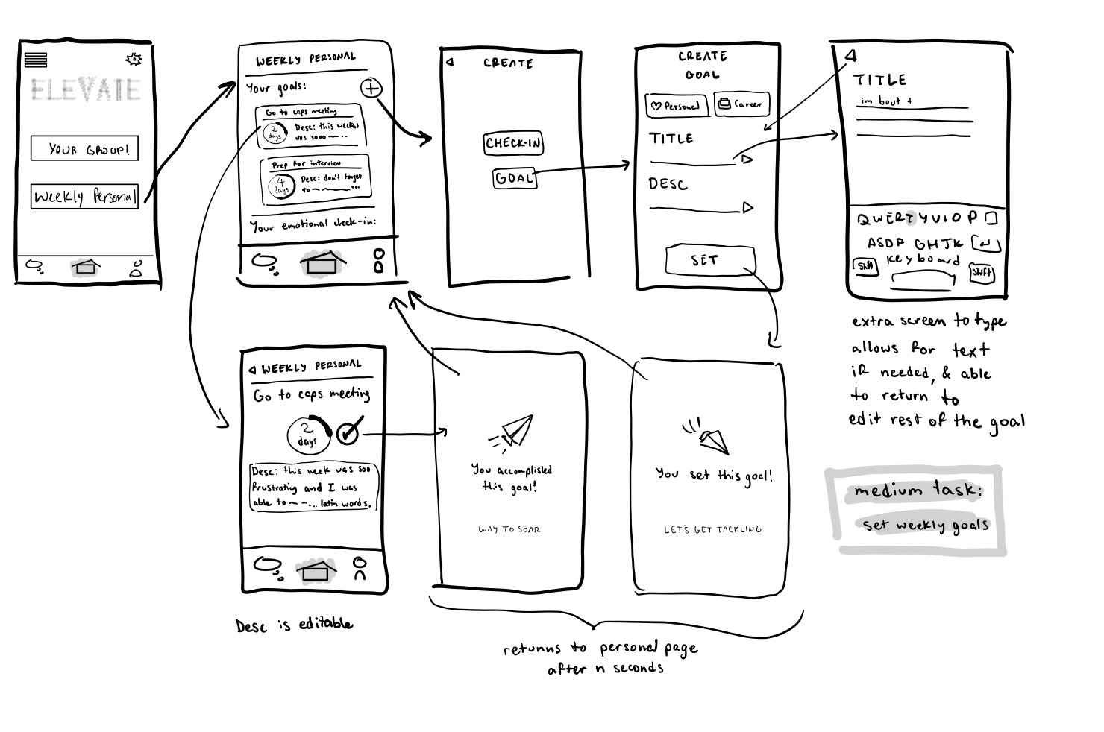
Original: Set Goals

Slide 17
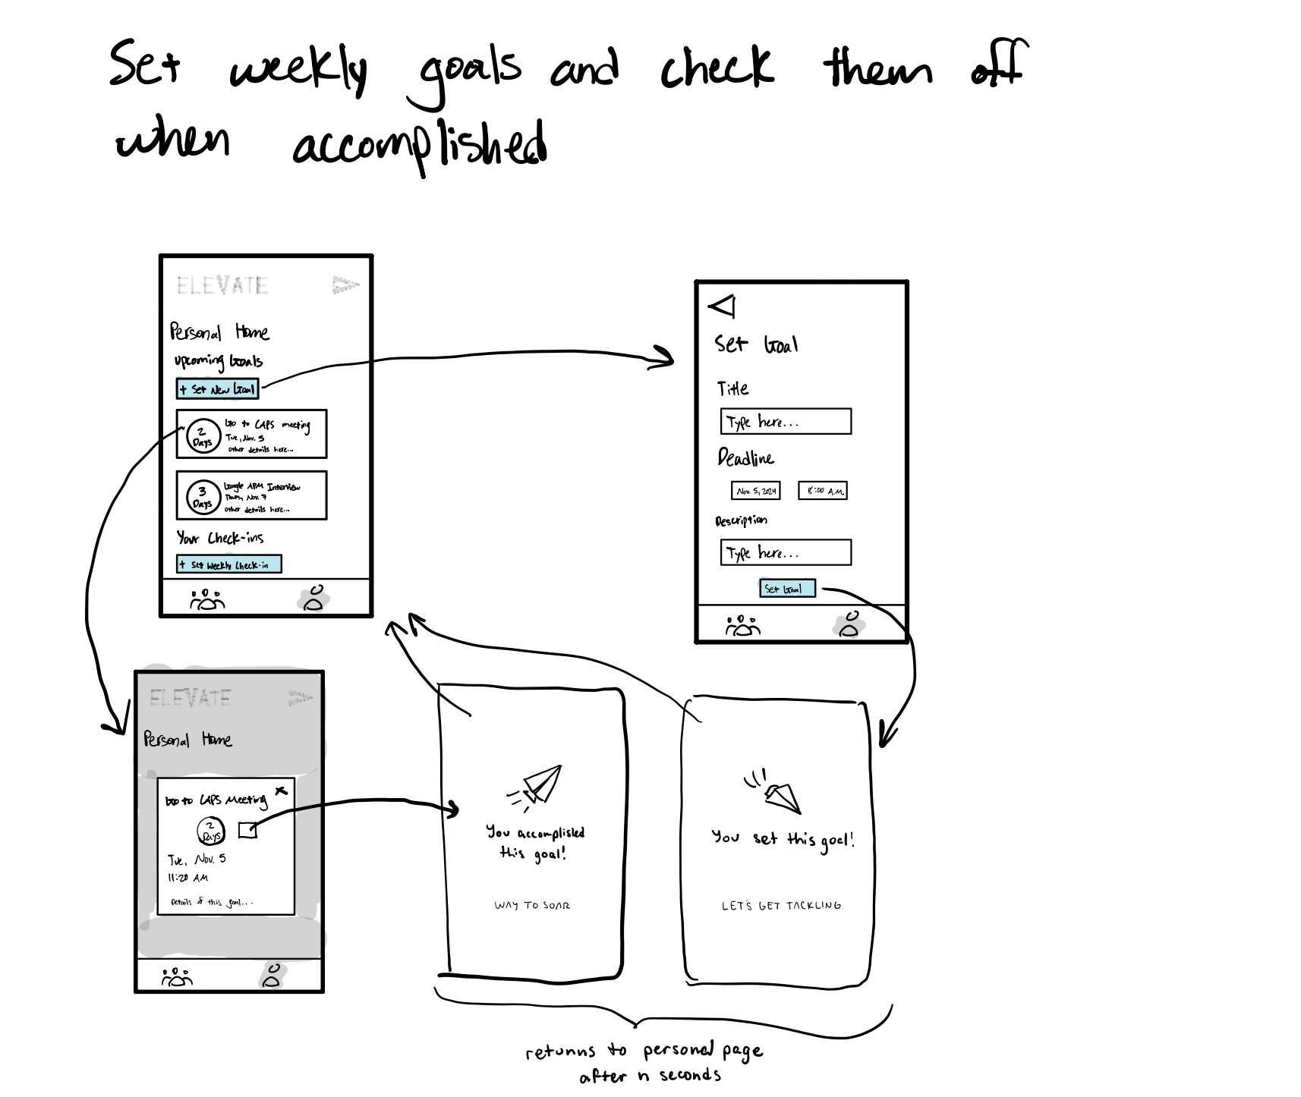
New: Set Goals
Description:
Fewer clicks required to view and set goals
Setting and viewing goals are both now in the Personal Home

Slide 18
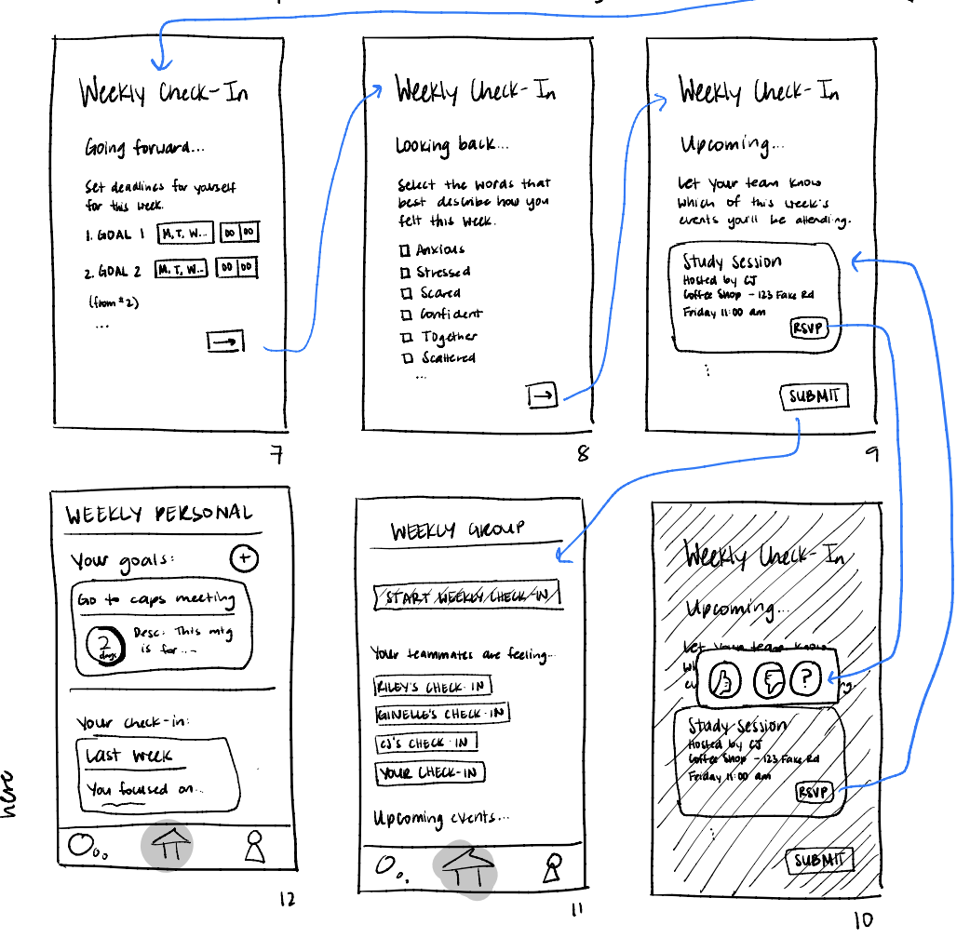
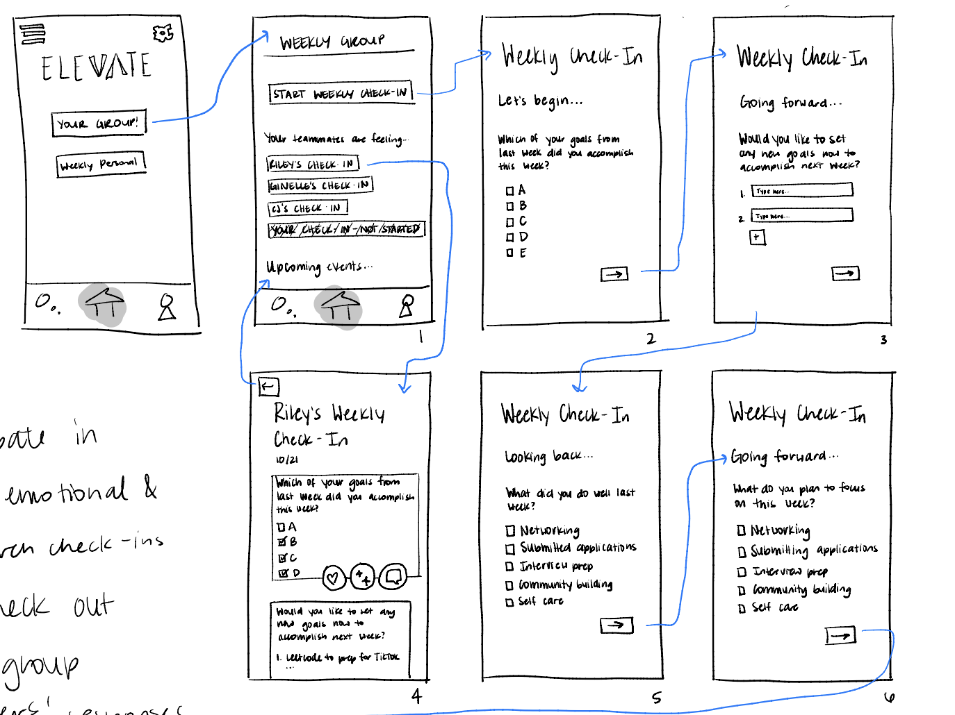
Original: Participate in Weekly Check-ins

Slide 19
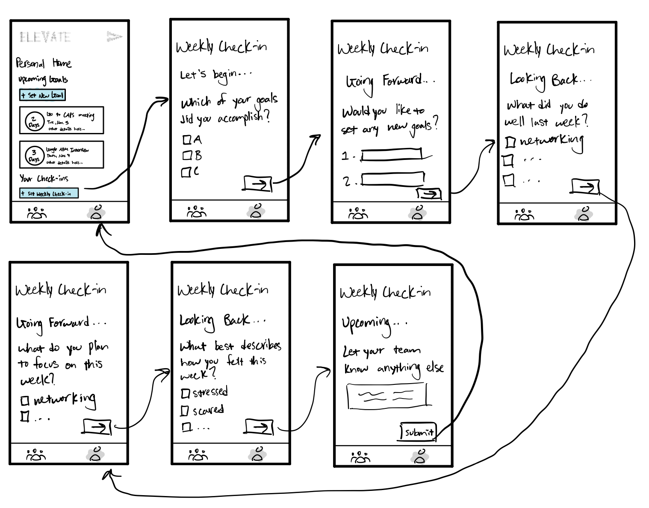
New: Participate in Weekly Check-ins
Description:
Fewer clicks to reach weekly check-in form
Completing it sends you back to the Personal Home tab

Slide 20
Revised Task Flows

Slide 21
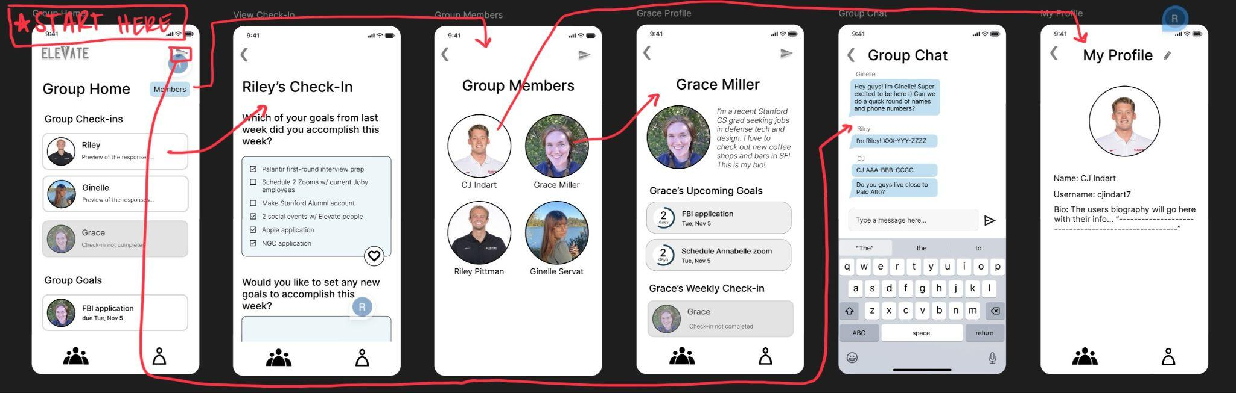
Medium-Fi Prototype Simple Task

Slide 22
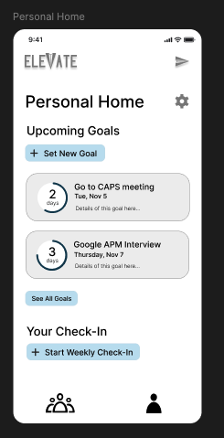
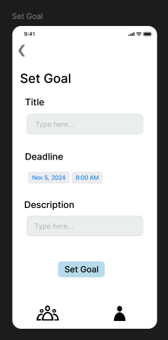
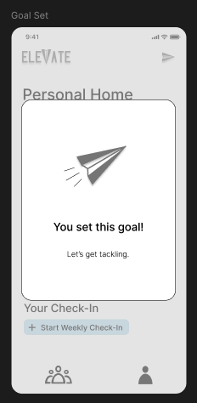
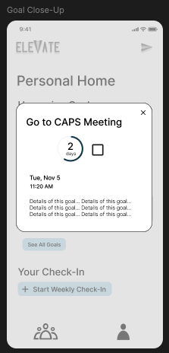
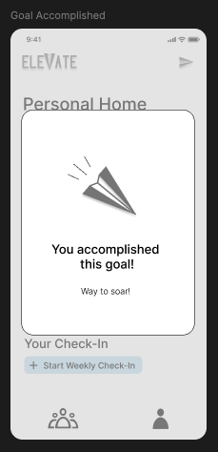
Medium-Fi Prototype Moderate Task

Slide 23
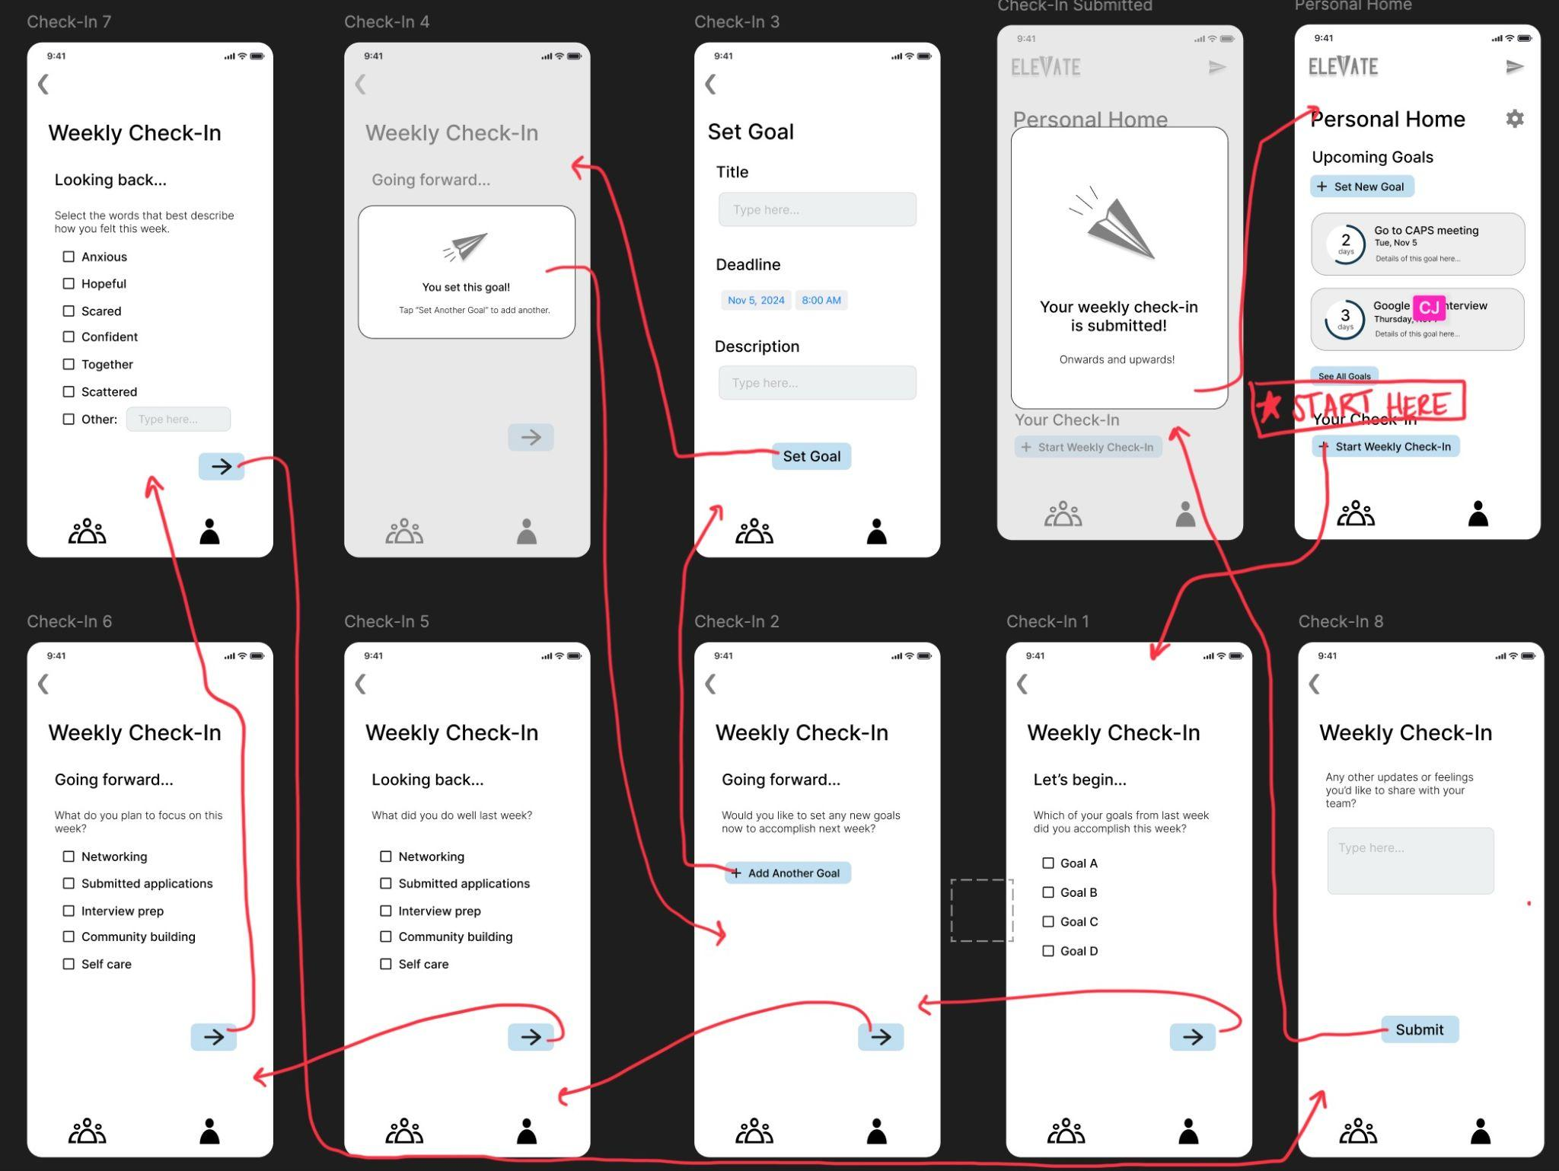
Medium-Fi Prototype Complex Task

Slide 24
Revised Sketches: Summary
Main feedback from last tests:
  We needed to rethink how we want users to add goals and complete check-in forms because it was confusing
Goals in each of new sketches:
  Allow task completion with fewer clicks and simplify the UI to make it more intuitive
  More information is present on the Group Home and Personal Home, so hopefully users have a better sense of direction

Slide 25
Prototype Implementation: Figma
Pros
Cons
Collaborative: we can work on it together at the same time
Effective for creating a realistic looking design
It takes a while to learn how to use Figma
Hard to allow for scrolling, text editing, etc. for the testers

Slide 26
Prototype Implementation
Things we hard-coded
  Since we have no users yet, we had to hard-code our group members, profiles, chats, check-in forms, and goals
Limitations
  The screens aren’t scrollable, so the Figma screens don’t display as much as they may on the actual app
  Unable to type in the text boxes and fill out responses yet

